Slide 1

Logistics Cost & Delivery Analytics (ADLS + ADF + Databricks + Power BI)
Group 1
Sourav Shetty
Drupad Dev
Mayur A
Ekta Patil
Sayana Dey

Slide 2
Project Overview
An automated, end-to-end analytics platform for logistics operations
Daily ingestion of shipment data
Data quality & governance built-in
Analytics-ready outputs for business users
Objectives
A single trusted dataset for cost and delivery metrics.
Industry-standard Medallion-Architecture model
A scalable real-time reporting Dashboard to analyze business criterias (SLA compliance, delivery performance, etc.)

Slide 3
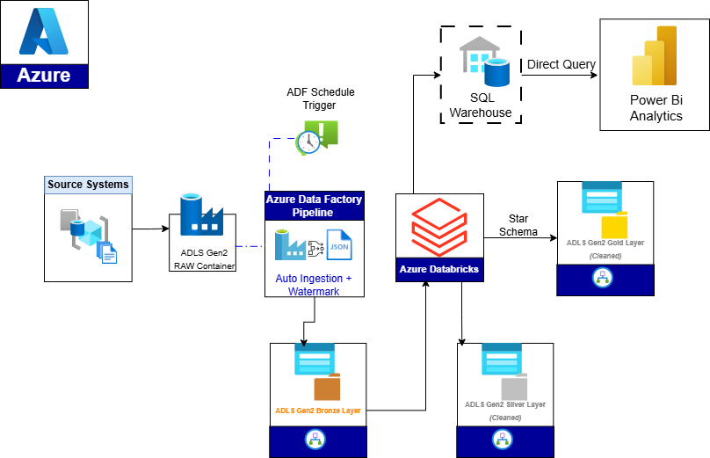
Azure Architecture
Detailed Orchestration of Data Flow

Slide 4
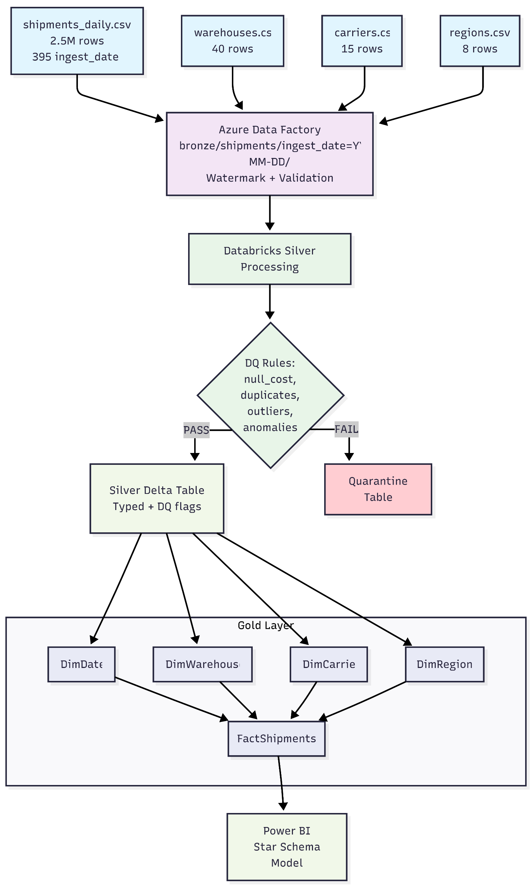
End-to-End Logistics Analytics Platform on Azure

Slide 5
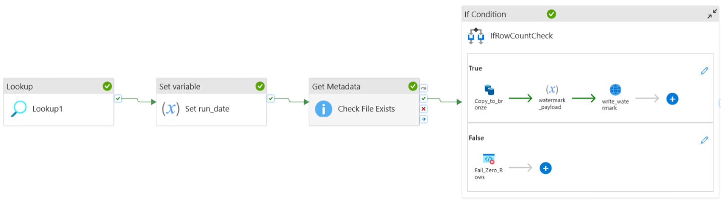
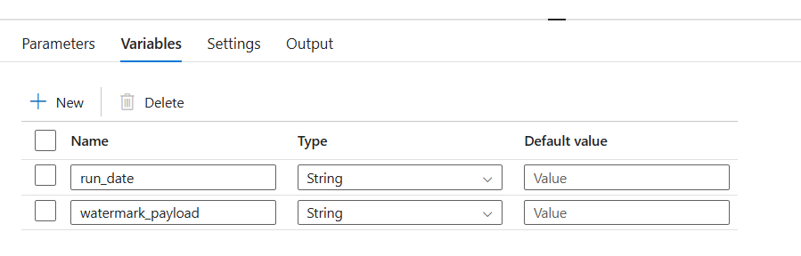
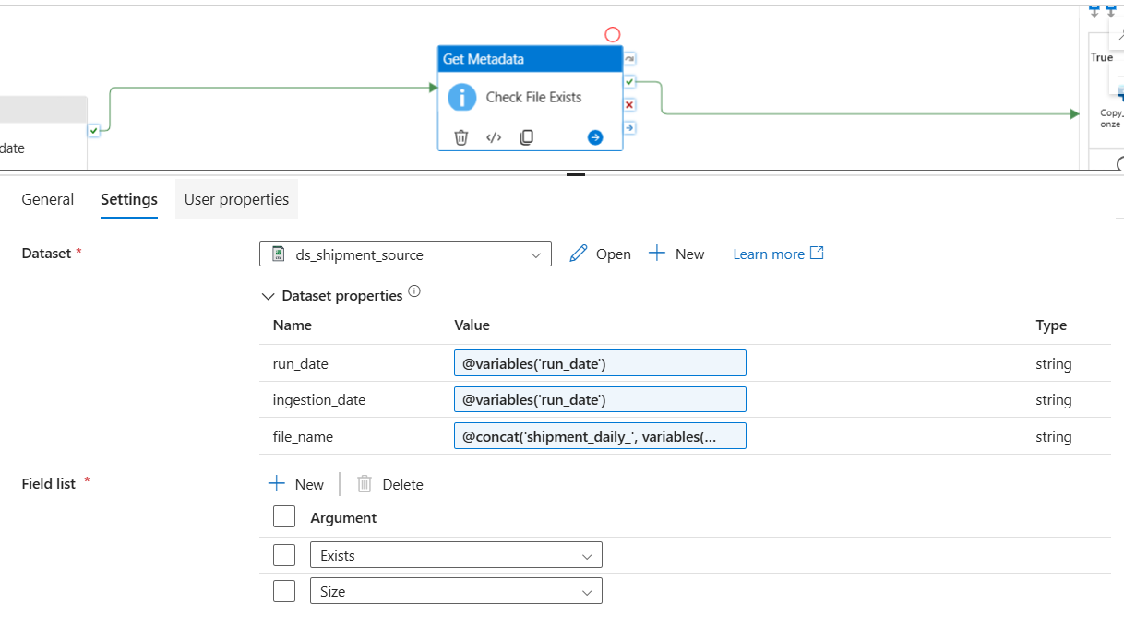
Data Orchestration with ADF

Slide 6
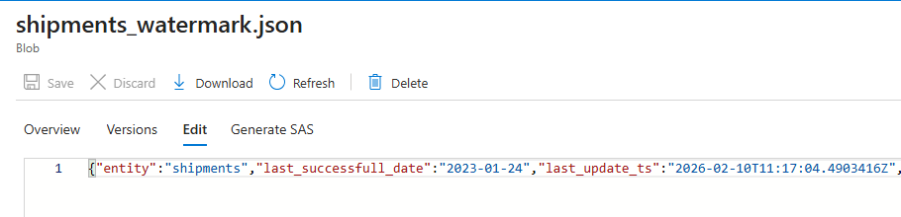
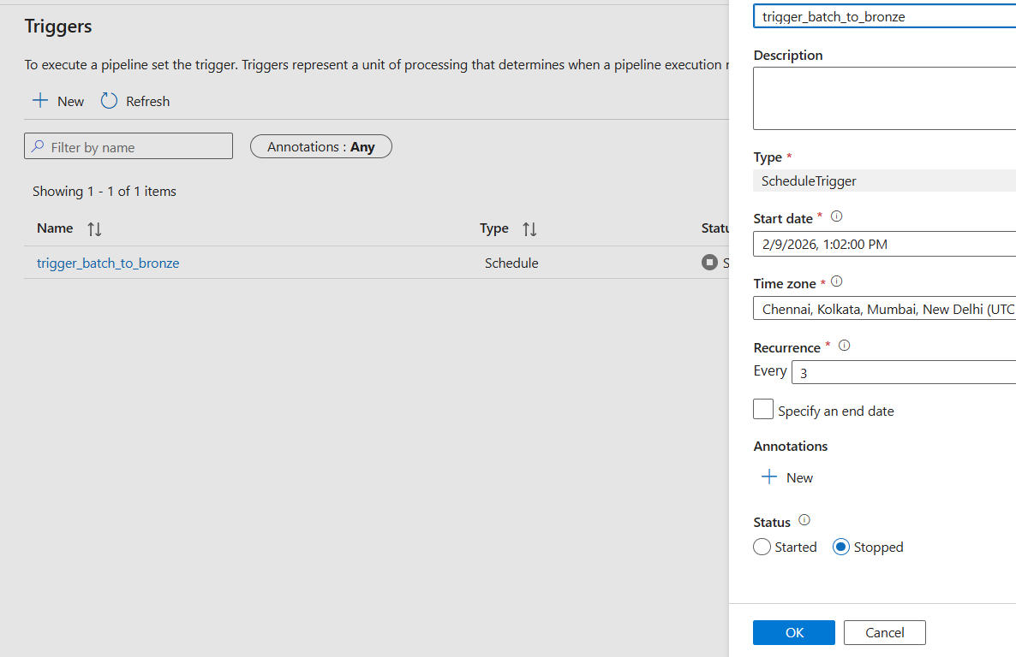
Watermark & Control Mechanism
Prevents reprocessing
Enables safe reruns
Industry-standard incremental pattern

Slide 7
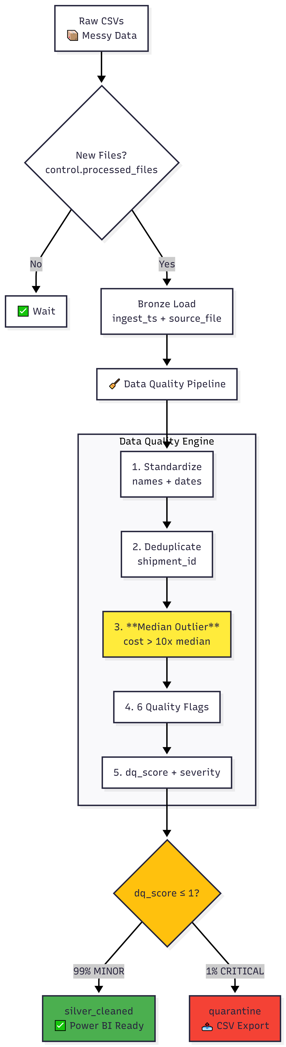
Databricks: Silver Transformations Data Cleaning & Quality
2.5M Shipment Records Analyzed
1. Missing shipment costs (NULL values)
2. Negative cost values
3. Zero cost shipments
4. Extreme cost outliers (10x+ median)
5. Date anomalies (shipment_date > delivery_date)
6. Invalid delivery status values
Step | Category | Operation | Purpose
1 | Cleaning | Column names → lowercase + underscores | SQL compatibility, consistency
2 | Cleaning | Trim ALL string columns | Remove leading/trailing whitespace
3 | Cleaning | carrierid, deliverystatus → UPPERCASE | Categorical standardization
4 | Cleaning | cost → double, dates → date, days → int | Explicit type enforcement
5 | Cleaning | Date parsing + logical validation | Reliable time analysis
6 | Cleaning | Dedup: latest ingest_ts per shipmentid | Eliminate duplicates
7 | Cleaning | Status/priority → controlled vocabulary | Consistent filtering
8 | Cleaning | Empty strings → NULL | Clear missing vs empty distinction

Slide 8
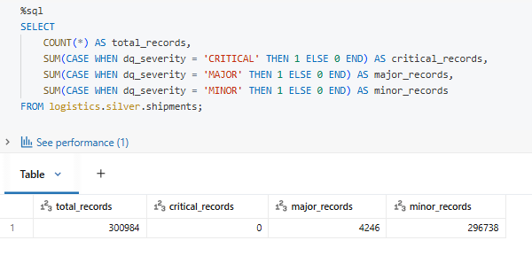
Field Name | Logic | Purpose
dq_score | Sum of all DQ flags (converted to integer 0/1) | Overall data quality score per record
dq_severity | ≥2 → CRITICAL, =1 → MAJOR, else MINOR | Severity classification
is_quarantine | dq_severity = 'CRITICAL' | Flag record for quarantine
Flag Name | Condition (Logic) | Description
dq_cost_null | shipment_cost IS NULL | Missing shipment cost
dq_cost_negative | shipment_cost < 0 | Invalid negative cost
dq_cost_zero | shipment_cost = 0 | Zero-cost shipment (potential anomaly)
dq_cost_outlier | shipment_cost > (median_cost × 10) | Extreme cost outlier detection
dq_date_anomaly | shipment_date > delivery_date | Illogical date sequence
dq_invalid_status | delivery_status NOT IN ('DELIVERED','IN_TRANSIT','CANCELLED') | Status outside controlled vocabulary

Slide 9
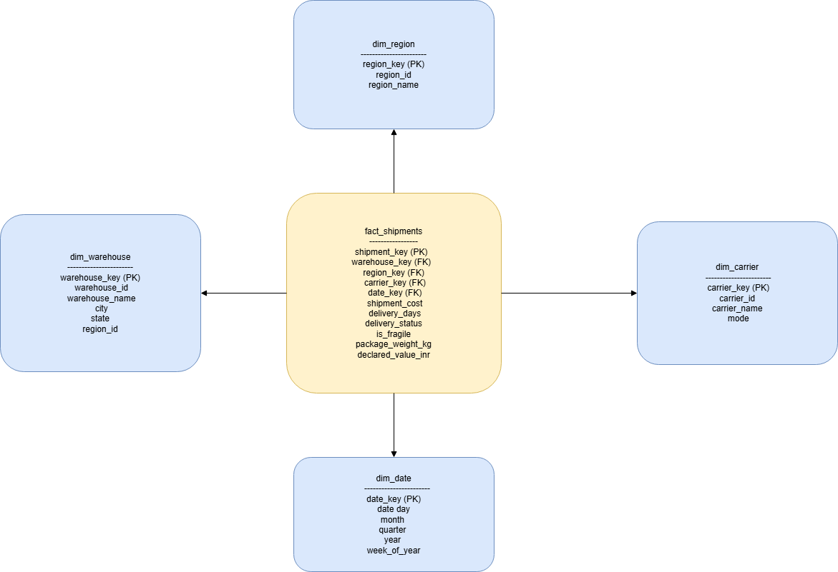
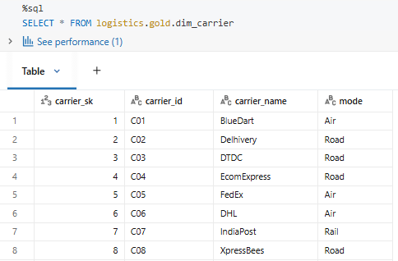
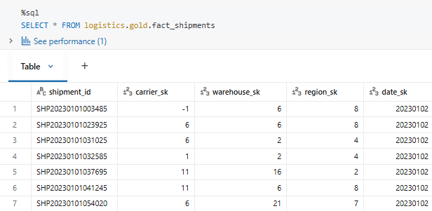
Analytics-Ready Gold Layer

Slide 10
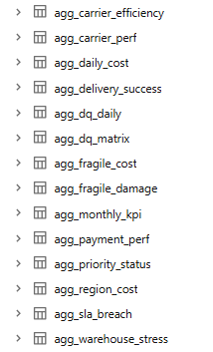
Aggregation Tables
Aggregation Table | What It Shows | KPI
agg_daily_cost | Daily shipment cost trend, Detects cost spikes | Cost per Day
agg_carrier_perf | Carrier on-time & speed comparison, Select best carrier | OTIF %
agg_region_cost | Avg cost by region, Identify regional imbalance | Regional Cost Variance
agg_delivery_success | % delivered within SLA, Improves customer satisfaction | On-Time Delivery
agg_payment_perf | Performance by payment type, Optimize payment efficiency | Payment Cycle Time
agg_priority_status | Priority shipment cost & delay, Ensure premium profitability | Priority Service Margin
agg_fragile_cost | Fragile vs normal cost, Identify handling premium | Fragile Handling Premium
agg_monthly_kpi | Monthly summary view, Executive monitoring | Executive Scorecard
agg_dq_daily | Daily data quality status, Ensure trusted reporting | Data Quality Score
agg_fragile_damage | Delayed fragile shipment risk, Reduce damage loss | Damage Risk Index

Slide 11
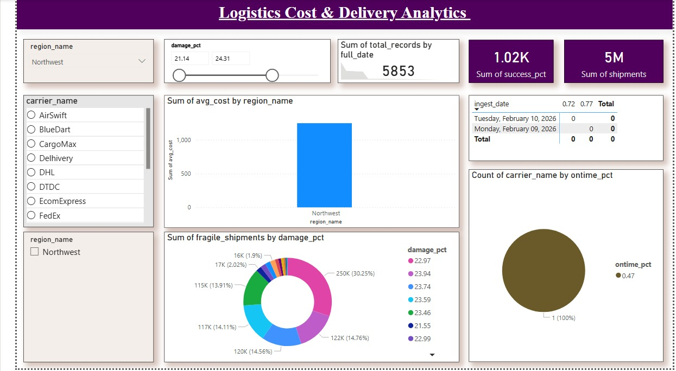
Power BI Insights

Slide 12
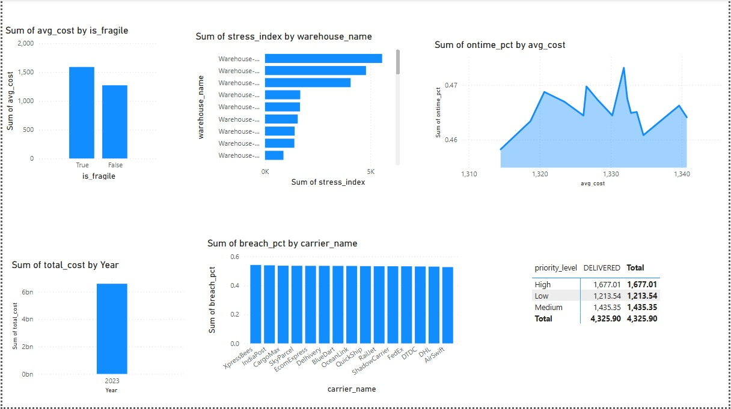

Slide 13
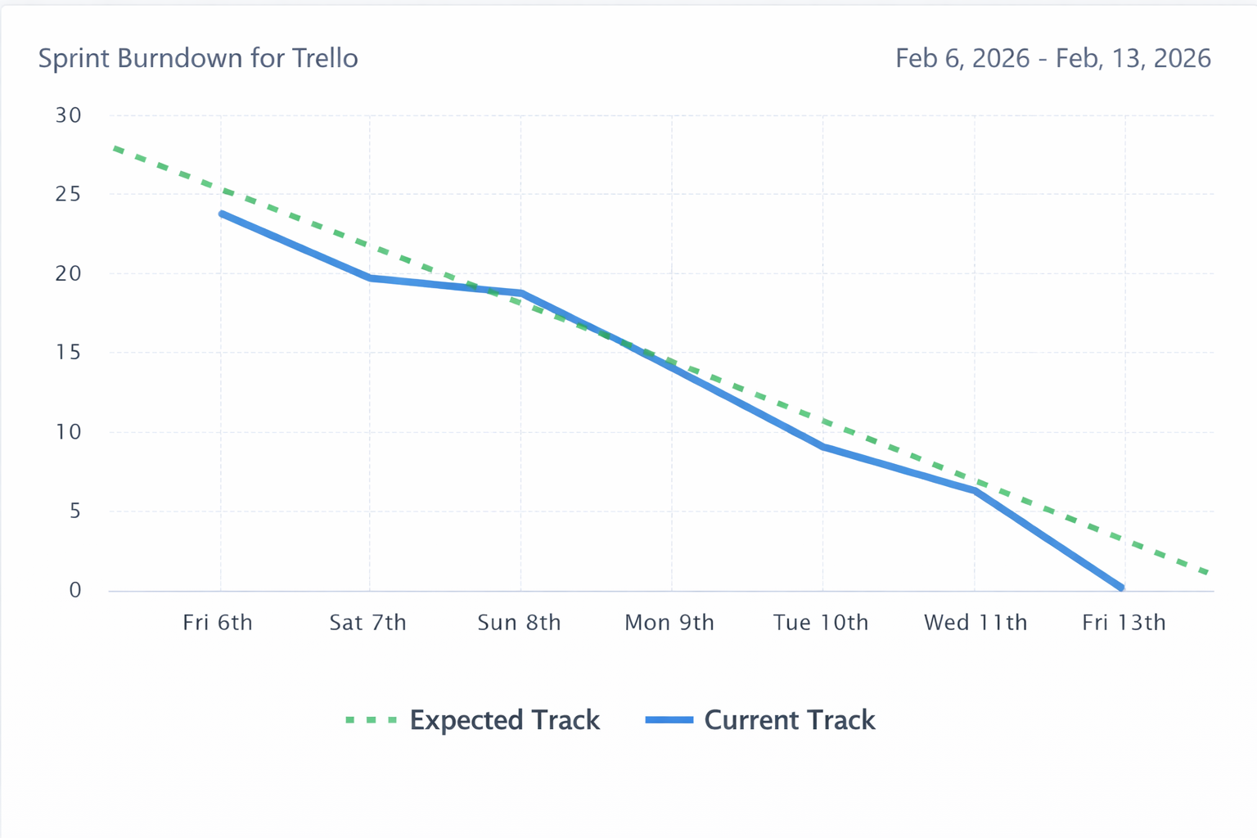
Trello Break Down Chart

